Slide 1
ALGORITHMS WARM-UP COMPETITION (BONUS)
DOCUMENT DISTANCE

Slide 2

WARM-UP COMPETITION – BONUS
Document Distance:
Given: two documents D1 & D2
Req.: Calculate distance between them d(D1, D2)?
CASE INSENSITIVE
Apps:
Search for similar documents
Detecting duplicates (e.g. Wikipedia mirrors)
Plagiarism detection
Definitions:
Word = sequence of alpha-numeric characters ONLY
Document = sequence of words (ignore space, punctuation, …etc.)
Treat all upper-case letters as if they are lower-case, so “Cat" & “cat" are same
Word end at a non-alphanumeric char, so "can't" contains 2 words: "can" & "t"

Slide 3
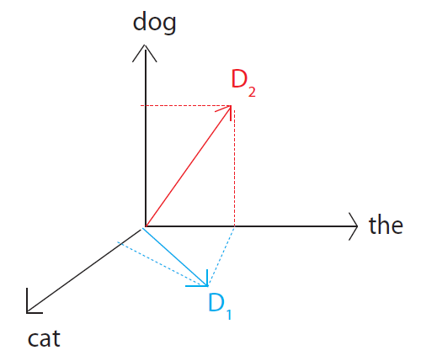



WARM-UP COMPETITION – BONUS
Document Distance:
Idea: define distance in terms of shared words.
Think of document D as a vector
D[w] = # occurrences of word w
Example: D₁ = “the cat” D₂ = “the dog”
D₁[“the”] = 1, D₁[“cat”] = 1
D₂[“the”] = 1, D₂[“dog”] = 1
d(D₁,D₂) = angle between 2 vectors.
0◦: identical, 90◦: no common words

Slide 4
WARM-UP COMPETITION – BONUS
Document Distance:
Algorithm:
Split each document into words
Count word frequencies (document vectors)
NOTE: Max Freq. Value BOUNDED BY 100,000
Compute distance

Slide 5
WARM-UP COMPETITION – BONUS
Document Distance:
Competition Rules:
Startup Code: C# Template – Check LMS
Criteria:
Correct O/P
Execution time
Delivery:
DUE TO: SUN 18 FEB 23:59
Submit ENTIRE content of “DocDistance.cs” at this form
Bonuses:
TOP 50
TOP 5
ALL-TIME TOP SCORE
Average Time = 261.26 ms
Max Time = 747 ms
@Intel Core i7 G11 2.8 GHz 16GB RAM

